Slide 1

Explanatory analyzes and Prediction of Outlet Sales using machine learning Models
By
Jobin Jose

Slide 2
Introduction
In this project I am focusing on to help the retailers to understand the properties of products and outlets that play crucial roles in predicting sales.
I will be analyzing the sales with different features using explanatory features of Python programming language
8523 rows of data with 11 different features has been used to predict the sales
Data has been cleaned and Preprocessed using different methods
Linear Regression Model and DecisionTreeRegressor Model
There will be comparison wo machine learning models are used for the prediction of sales
The two machine learning models based on different metrics
Coefficient of Determination and Root mean squared error (RMSE): square root of the mean of the squared errors
Regularization of Models has been done to find the best model for prediction

Slide 3
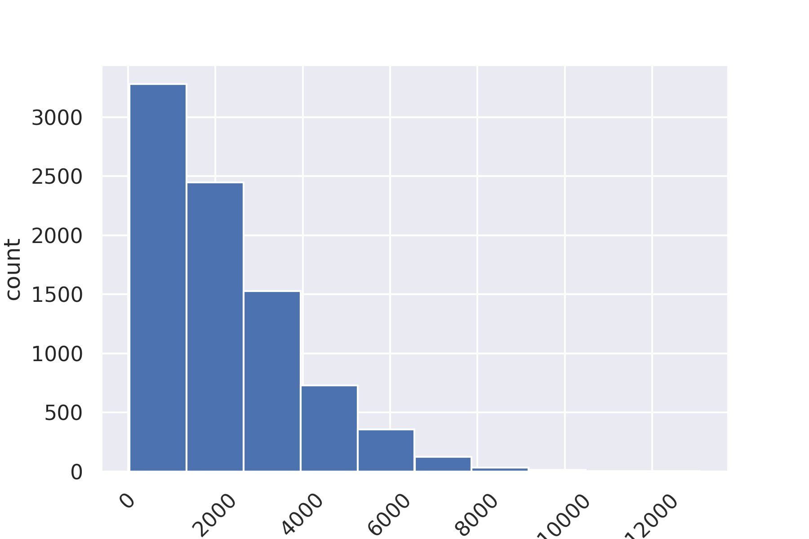
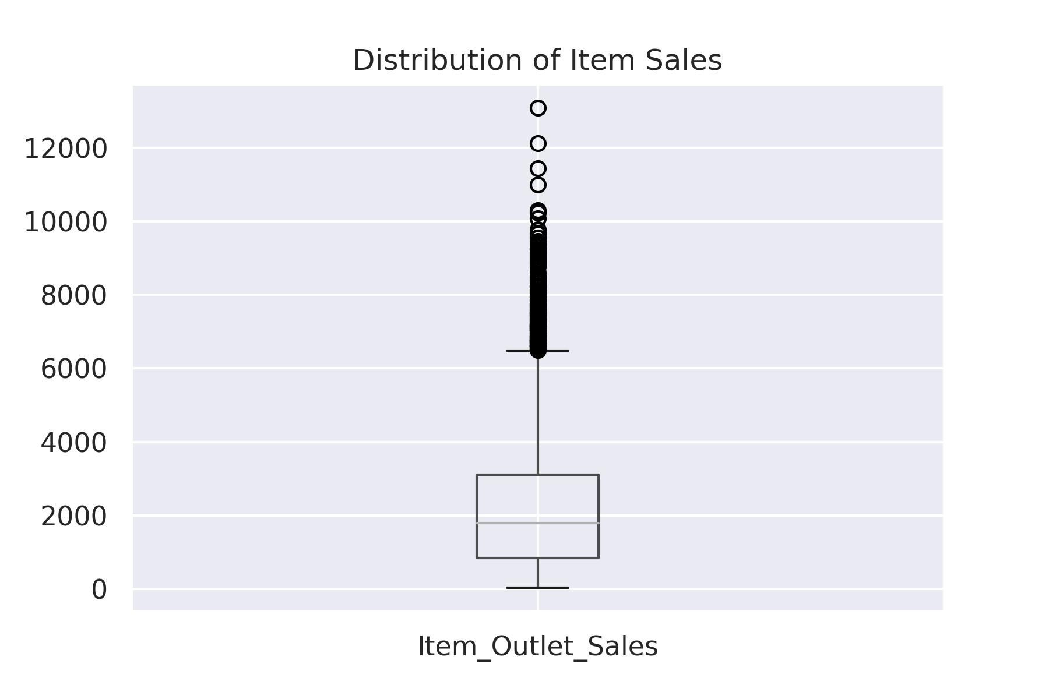
Explanatory Analysis of Outlet Sales
Most of the Outlet sales are in are happening in between 100 to 2000 dollars in which
There is no sales over 8000 dollars
STATSTICAL SUMMARY OF SALES
We can see that average sales of the Items are 1794.3 , maximum Price of the Item is 13086.6,Minimum Price is 33.2
also there are outliers above 10000 and two above 12000

Slide 4
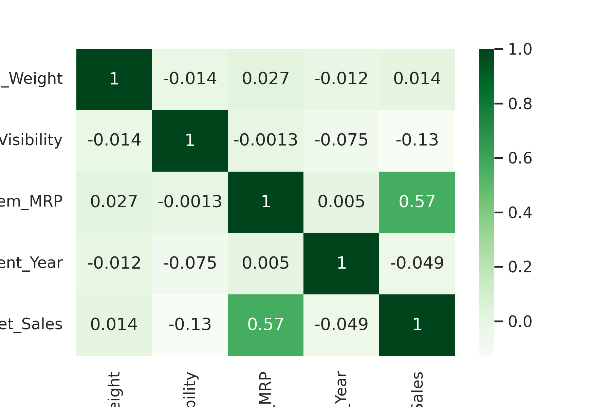
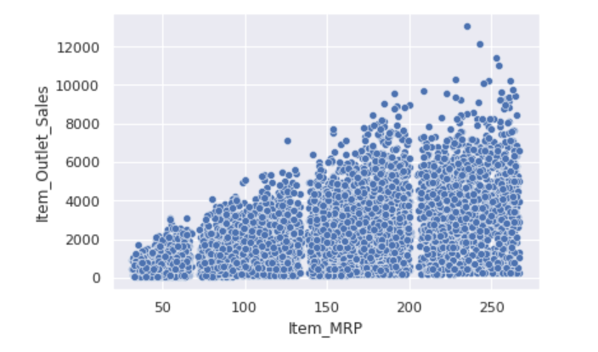
CORELATION OF SALES WITH OTHER FEATURES
We can see outlet sales is highly corelated to Item MRP, that means Item MRP plays great role in predicting sales price , Features such as Item Visibility ,Item Year have negative correlation with sales
The scatter plot clearly explains Positive correlation, which means when Item MRP increases Outlet sales increases

Slide 5
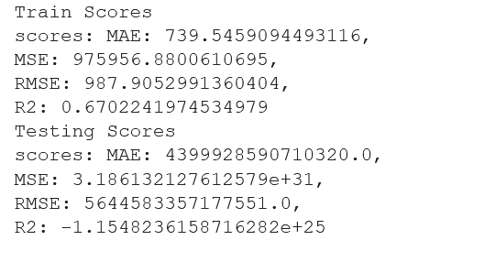
Machine Learning Model Evaluation
Linear Regression Model
In linear Regression evaluation model I used analyses metrics of ‘Coefficient of Determination’ called R2 and Root mean squared error (RMSE): square root of the mean of the squared errors.
I did R2 and RMSE on both training and test data
Performance metrics results :
When we analyze the scores on both set of data we can see this model is showing High bias and also High variance which makes this mode underfit
So I used KNeighborsRegressor
Model method to tune and regularize the model And Best Parameters are selected

Slide 6
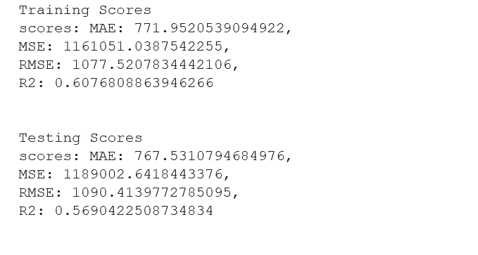
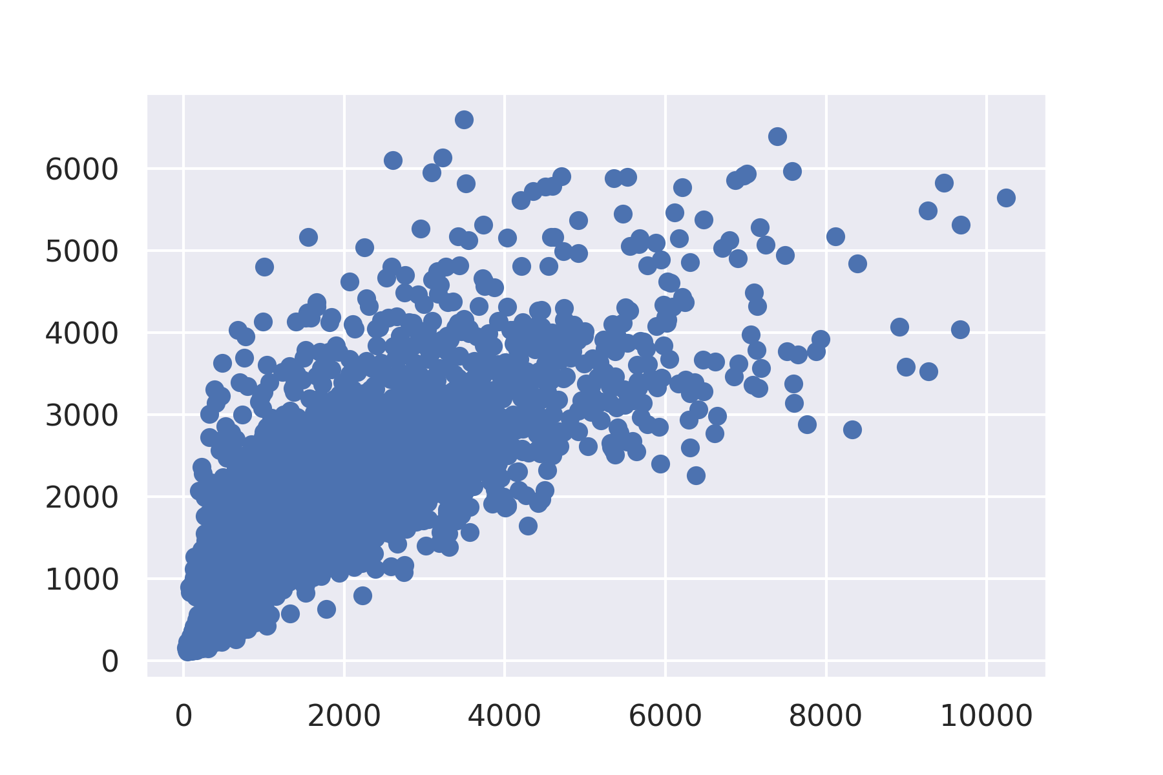
KNeighborsRegressor Model Evaluation
When I used KNeighborsRegressor method with best K-N neighbor to tune the data we can see scores changed become closer
The scatter plot clearly explains the after tuning the data predicting sales has positive correlation with features

Slide 7
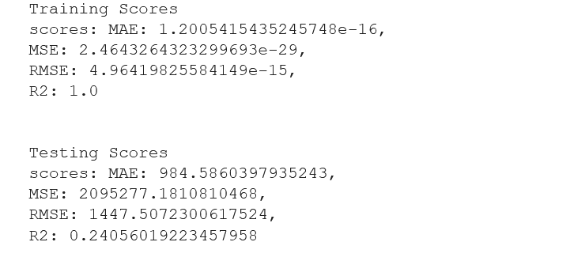
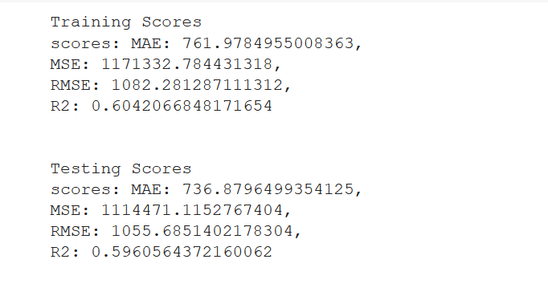
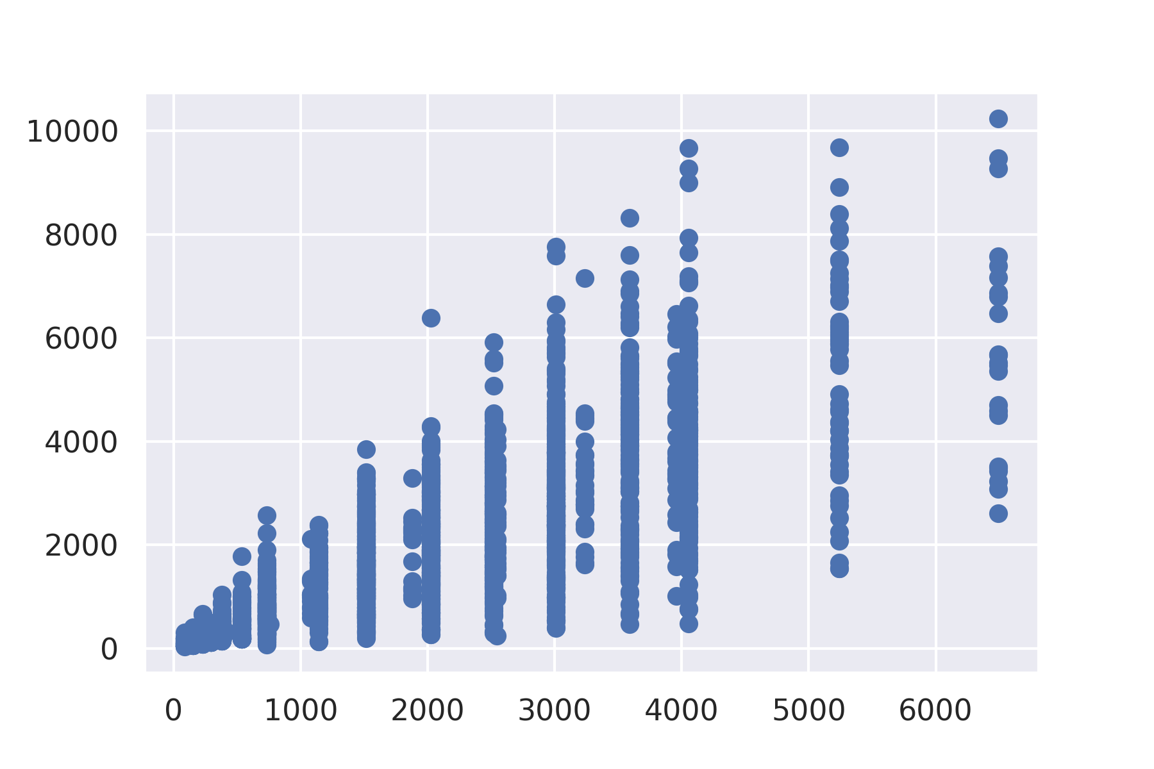
Simple Regression Tree Model - DecisionTreeRegressor
We can see there is high difference in both RMSE and R2 score between training and test scores that means these model has High Variance (Underfit)
After tuning the model we can see the both RMSE and R2 on test and train scores become closer which makes the model a good fit
We can see from the scatterplot the prediction are highly showing positive correlation to features in after tuning

Slide 8
Conclusion
Analyses of Outlet Sales prediction with different features has been done
Sales prediction is highly related to Item MRP feature.
Prediction's are done using Linear Regression model DecisonTreeRegressor Model
Evaluation of both models are done using performance metrics, and tuning methods are also used
We can see performance metrics DecisonTreeRegressor model resulted as Good Fit compared to Linear Regression
So I’m recommending DecisonTreeRegressor Over Linear Regression
DecisionTreeRegressor Model will be more useful for predicting Sales

